Slide 1
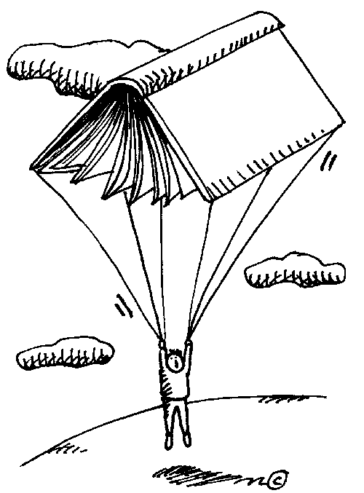
Independent Novel Options
Level III

Slide 2
Adventures of Huckleberry Finn (90)
Huckleberry Finn has been taken in by Widow Douglas and her sister, Miss Watson, who intend to teach him proper manners, cleanliness, school, and religion. Huck, however, encounters bad luck and through the course of his own escape, meets Jim, the widow’s slave. This tale comes alive as Huck tells the story of his and Jim’s adventures in their search for freedom, as well as the story of his own enlightenment in a society that he once thought was free and equal.
Recommended: Upper Secondary
Genre: Historical Fiction
Pages: 327

Slide 3
A Day on the Ridge (15)
This is a memoir of Newfoundlander Gary Collin’s life as a woodsman growing up in Bonavista in the 1950s. Learning the skills from his father, Collins recalls for the reader his life as an outdoorsman. The nearly two dozen varied stories from the book about canoeing down dangerous rivers, moose hunting, and coming from the woods for Christmas, are based on diary entries that he kept for four decades.
This memoir is a testament to the hardworking family men of the time.
Recommended: Secondary
Genre: Nonfiction
Pages: 211

Slide 4
A Matter of Honor (121)
A disgraced British colonel bequeaths a mysterious letter to his only son. But the moment Adam Scott opens the yellowing envelope, he sets into motion a deadly chain of events that threatens to shake the very foundations of the free world. Within days, Adam's lover is brutally murdered and he's running for his life through the great cities of Europe, pursued not only by the KGB, but by the CIA and his own countrymen as well. Their common intent is to kill him before the truth comes out. While powerful men in smoke-filled rooms plot ever more ingenious means of destroying him, Adam finds himself betrayed and abandoned even by those he holds most dear. When at last he comes to understand what he is in possession of, he's even more determined to protect it, for it's more than a matter of life and death-it's a matter of honor.
Recommended: Secondary
Genre: Thriller, Spy fiction
Pages: 368

Slide 5
A Winter’s Tale (131)
New York City is subsumed in arctic winds, dark nights, and white lights, its life unfolds, for it is an extraordinary hive of the imagination, the greatest house ever built, and nothing exists that can check its vitality. One night in winter, Peter Lake, orphan and master-mechanic, attempts to rob a fortress-like mansion on the Upper West Side. Though he thinks the house is empty, the daughter of the house is home. Thus begins the love between Peter Lake, a middle-aged Irish burglar, and Beverly Penn, a young girl, who is dying. Peter Lake, a simple, uneducated man, because of a love that, at first he does not fully understand, is driven to stop time and bring back the dead. His great struggle, in a city ever alight with its own energy and besieged by unprecedented winters, is one of the most beautiful and extraordinary stories of American literature.
Recommended: Upper Secondary
Genre: Literary Fiction
Pages: 768

Slide 6
A Night to Remember (27)
A riveting account of the Titanic's fatal collision and the behavior of the passengers and crew, both noble and ignominious. Some sacrificed their lives, while others fought like animals for their own survival. Wives beseeched husbands to join them in lifeboats; gentlemen went taut-lipped to their deaths in full evening dress; and hundreds of steerage passengers, trapped below decks, sought help in vain. Recommended: Secondary
Genres: History
Pages: 208

Slide 7
Away (15)
A stunning, evocative novel set in Ireland and Canada, Away traces a family’s complex and layered past. The narrative unfolds with shimmering clarity, and takes us from the harsh northern Irish coast in the 1840s to the quarantine stations at Grosse Isle and the barely hospitable land of the Canadian Shield; from the flourishing town of Port Hope to the flooded streets of Montreal; from Ottawa at the time of Confederation to a large-windowed house at the edge of a Great Lake during the present day. Graceful and moving, Away unites the personal and the political as it explores the most private, often darkest corners of our emotions where the things that root us to ourselves endure. Powerful, intricate, lyrical, Away is an unforgettable novel.
Recommended: Upper Secondary
Genres: Fiction, Historical drama, Speculative fiction
Pages: 368

Slide 8
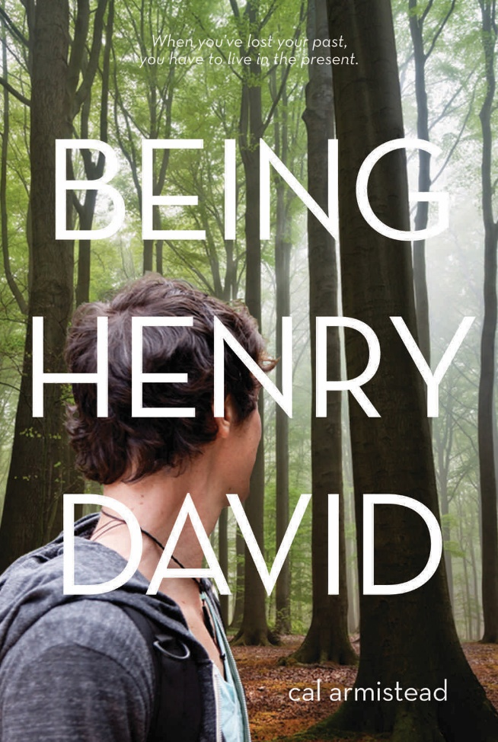
Being Henry David (20)
Imagine waking up in the middle of Penn Station with no idea who you are, where you’re from, or how you got there. For seventeen year old Hank, the only clue to his identity is a copy of Walden by Henry David Thoreau, which appears to be his only possession. Hank, or Henry David as he also calls himself, struggles with his identity, reclaiming his memories, and the emotions that arise in connection to his past, but learns that when you can’t look back, you must move forward.
Recommended: Middle Secondary
Genre: Contemporary/Realistic Fiction
Pages: 304

Slide 9
Dracula (132)
Dracula is an 1897 Gothic horror novel by Irish author Bram Stoker. Famous for introducing the character of the vampire Count Dracula, the novel tells the story of Dracula's attempt to move from Transylvania to England so he may find new blood and spread the undead curse, and the battle between Dracula and a small group of men and women led by Professor Abraham Van Helsing. Dracula has been assigned to many literary genres including vampire literature, horror fiction, the gothic novel and invasion literature. Although Stoker did not invent the vampire, he defined its modern form, and the novel has spawned numerous theatrical, film and television interpretations.
Recommended: Upper Secondary
Genre: Horror fiction, Gothic fiction
Pages: 488

Slide 10
Face Off (20)
Seventeen year-old Alex Petrovic is a goalie for Team British Columbia. During a game against a team from Eastern Europe, Alex meets Stefan Divac, a goalie for the opposing team who looks a lot like him. While he considers it a strange coincidence, his mother reacts very differently. They all soon learn that as past secrets come to light, knowledge of the past opens up a new and complicated world involving murder, escape, and the desire for justice.
Recommended: Middle Secondary
Genre: Action/Adventure
Pages: 304

Slide 11
Heist Society (15)
Katarina Bishop has been a part of her family’s criminal lifestyle since she was a child. Now a teenager, she is determined to live a normal life, and decides to leave her former life behind after she cons her way into a boarding school. Unfortunately, the robbery of a mobster’s priceless art collection forces her to reconsider after her father is implicated in the crime. She is quickly torn between the love of her family and her newfound freedom.
Recommended: Lower – Middle Secondary
Sequel: Uncommon Criminals
Genre: Mystery
Pages: 287

Slide 12
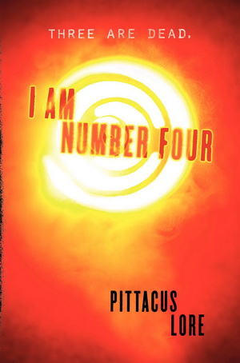
I am Number Four (35)
I Am Number Four is the story of Lorien aliens and their guardians hiding in different places on earth from the rival intergalactic group, the Mogadorians. Nine aliens escaped their home planet Lorien, but only six are still alive. They have to be killed in order for the Mogadorians to dominate. Number 4 is John Smith, a teen currently living/hiding in Ohio. While developing his paranormal powers in preparation for a possible invasion, John tries to live the life of a somewhat normal teen with his guardian-father Henri. However the inevitable happens and John must find a way to survive.
Recommended: Middle Secondary
Sequel: The Power of Six
Genre: Science Fiction
Pages: 440

Slide 13
Life of Pi (15)
Pi Patel is a young boy from Pondicherry, India where he lives at a zoo owned and operated by his family. As the political situation in 1970’s India becomes unsettled, Pi’s family sells the zoo and its animals and sets off to start a new life in Canada. Aboard their ship are many of the zoo animals also setting off for their new homes in North America. Tragically, the cargo ships sinks, taking Pi’s family with it and leaving Pi alone in the Pacifi c Ocean with a hyena, an orangutan, an injured zebra, and Richard Parker (a 450-pound tiger) as companions. Pi’s incredible journey lasts several months and shows no limits when it comes to survival.
Recommended: Upper Secondary
Genre: Fantasy
Pages: 354

Slide 14
Mind Games (15)
The story is told in flashback and first person point of view, alternating between the two main characters, sisters Fia and Annie. Both girls have psychic powers: Fia’s instincts are always right and Annie is blind but has visions of the future. They are in a school for “special girls” run by males who use the girls’ talents for corporate espionage. Girls at the school are either a Seer, Feeler, or Reader but Fia is none of those things, and that makes her different and dangerous.
Recommended: Lower – Middle Secondary
Sequel: Perfect Lies
Genre: Fantasy/Thriller
Pages: 241

Slide 15
Monster (36)
Sixteen year old Steve Harmon is called ‘Monster’ by the judge after his apparent involvement in a fatal shooting. Readers look into the life of Steve in this novel through journal writings which provide insight into his life before the murder and his experiences and feelings while being held in prison before the trial. The reader becomes both the juror and the witness during the most difficult.
Recommended for: Lower Secondary Genre: Dram, crime novel, mystery
Pages: 281

Slide 16
Of Mice and Men (19)
George, a small, quick man, and Lennie, a large man with the mind of a child, have become an unlikely pair. Both are laborers in California’s dusty vegetable fields and have become family to each other in the face of loneliness and a life of poverty. Just when their dreams of each owning a piece of land seem to be within reach, they are faced with lessons and choices that cannot be changed.
Recommended for: Lower Secondary
Genre: Historical Fiction
Pages: 103

Slide 17
Pieces of Me (15)
Jessica, a beautiful, introverted, high school student, dies on the way to her very fi rst party. In an attempt to give meaning to her death, her parents donate her organs to other teens who otherwise might not survive. Unfortunately, Jessica doesn’t appreciate being dissected and begins to follow the recipients of her organs. It is through her ties with these teens and their struggles and triumphs that Jessica begins to realize the importance of the role she has played and can continue to play.
Recommended for: Lower – Middle Secondary
Genre: Contemporary Fiction
Pages: 284

Slide 18
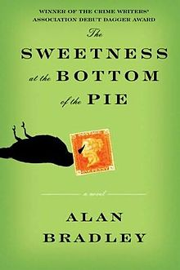
The Sweetness at the Bottom of the Pie (15)
Eleven year-old Flavia de Luce, narrator of the story, is a budding chemist who dabbles in poisons. The story takes place in the summer of 1950 in a large English manor house where Flavia lives with her family. Intelligent and independent, Flavia is excited to take on the role of detective when she finds a man dead in her garden. Flavia`s crime-solving abilities are put to the test when her family is placed under suspicion and she must uncover the truth amongst mounting deceptions.
Recommended for: Middle – Upper Secondary
Sequel: The Weed That Strings the Hangman’s Bag
Genre: Historical/Mystery
Pages: 373

Slide 19
Schindler’s List (108)
Schindler's List recreates the true story of Oskar Schindler, the Czech-born southern German industrialist who risked his life to save over 1,100 of his Jewish factory workers from the death camps in Nazi-occupied Poland. Thomas Keneally's "documentary novel," based on the recollections of the Schindlerjuden (Schindler's Jews), Schindler himself, and other witnesses, is told in a series of snapshot stories. It recounts the lives of the flamboyant profiteer and womanizer Schindler; Schindler's long-suffering wife, Emilie; the brutal SS (Nazi secret service) commandant Amon Goeth; Schindler's quietly courageous factory manager, Itzhak Stern; and dozens of other Jews who underwent the horrors of the Nazi machinery.
Recommended for: Middle – Upper Secondary
Genres: Biographical novel
Pages: 429

Slide 20
Stone Angel ( )
Margaret Laurence introduces Hagar Shipley, one of the most memorable characters in Canadian fiction. Stubborn, cantankerous, self-reliant – and, at ninety, with her life nearly behind her – Hagar Shipley makes a bold last step towards freedom and independence. As her story unfolds, we are drawn into her past. We meet Hagar as a young girl growing up in a black prairie town; as the wife of a virile but unsuccessful farmer with whom her marriage was stormy; as a mother who dominates her younger son; and, finally, as an old woman isolated by an uncompromising pride and by the stern virtues she has inherited from her pioneer ancestors. Recommended for: Upper Secondary
Genre: Canadian Fiction
Pages: 328

Slide 21
Side Control (3)
The second novel in a series that focuses on the physical and life skills learned at a martial arts dojo, Side Control centers around Jackson James as he tries to remain honest so he can become a mixed martial arts fighter and eventually a member of the United States Special Forces. With tough choices to make, Jackson must continuously decide whether he is making the right ones.
Recommended: Lower Secondary
Sequel: Head Kick; Body Shot
Pages: 120
Genre: Contemporary/Realistic Fiction Pages:

Slide 22
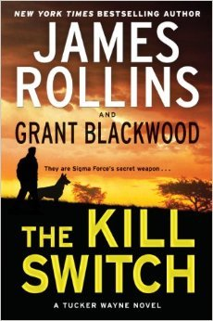
The Kill Switch (35)
Captain Tucker Wayne, former US Army Ranger and his military dog, Kane, are given a mission: get a Russian scientist, who has knowledge of a doomsday plant, out of Russia to the US and keep him from being killed. Sometimes the story is told from Kane’s point of view which makes for interesting story-telling. It is a fast-paced, entertaining thriller about eco-terrorism.
Recommended: Upper Secondary
Genre: Action/Adventure
Pages: 384

Slide 23
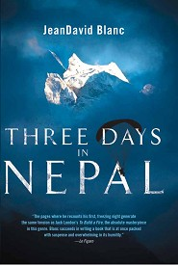
Three Days in Nepal (15)
This is the true story of JeanDavid Blanc, an Internet entrepreneur based in Paris who grew up with a fascination for flying. On a paragliding trip across the Himalayas, Blanc crashes into the side of a mountain, grabbing on to a bush to prevent himself from falling. He sends out an SOS with his GPS, but weather makes it very difficult for a rescue attempt. Alone on the side of a mountain, Blanc has to figure out how he can survive to get back home to his daughter.
Recommended: Lower Secondary.
Genre: Nonfiction
Pages: 127

Slide 24
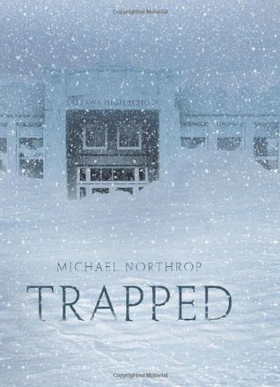
Trapped (20)
When Scotty decides to stay after school to work on a project, he has no idea the impact it will have. After a freak snow storm disables their town, Scotty and his friends are forced to spend the night in their school. But when one night turns into another, and things start to go terribly wrong, they must carry on with no heat, no power, and a dwindling food supply while the snow outside piles higher. Scotty and his friends are forced to make tough decisions in order to survive.
Recommended: Lower Secondary
Genre: Contemporary/Realistic Fiction
Pages: 232

Slide 25
The Catcher in the Rye (36 +)
Holden Caulfield, a seventeen year old prep school student, tells the story of his twenty-four hour stay in New York City after he is kicked out of school. He relates his struggles with the phoniness of the adult world while attempting to deal with the death of his younger brother. Holden deals with other troubling childhood experiences as he searches for truth and belonging in a world where he feels completely alienated.
Recommended: Upper Secondary
Genre: Realistic Fiction
Pages: 277

Slide 26
The Fellowship of the Ring (17)
Frodo Baggins knew the Ring wraiths were searching for him—and the Ring of Power he bore that would enable Sauron to destroy all that was good in Middle-earth. Now it was up to Frodo and his faithful servant Sam to carry the Ring to where it could be destroyed—in the very center of Sauron's dark kingdom.
Recommended for: Upper Secondary
Genre: Fantasy
Canadian Fiction
Pages: 398

Slide 27
The Pigman ( ?)
John and Lorriane are two high school students who come from unhappy homes but are glad that they have each other. They prefer to hang out and play practical jokes rather than go to school. Through one practical prank, they meet a lonely old man, Mr Pignati. An intense friendship develops and the three create a strange world until Mr Pignati’s death. This book is the ‘Memorial Epic’ of their friendship.
Recommended: Lower Secondary
Genre: Realistic Fiction
Pages: 166

Slide 28
The Wreckers (29)
There was once a village bred by evil. On the barren coast of Cornwall, England, lived a community who prayed for shipwrecks, a community who lured storm-tossed ships to crash upon the sharp rocks of their shore. They fed and clothed themselves with the loot salvaged from the wreckage; dead sailors' tools and trinkets became decorations for their homes. Most never questioned their murderous way of life. Then, upon that pirates' shore crashed the ship The Isle of Skye. And the youngest of its crew members, 14-year-old John Spencer, survived the wreck. But would he escape the wreckers? This is his harrowing tale
Recommended: Lower Secondary
Genres: Fiction, Historical drama
Pages: 224

Slide 29
The Kite Runner (6)
Amir is the son of a wealthy Kabul merchant, a member of the ruling caste of Pashtuns. Hassan, his servant and constant companion, is a Hazara, a despised and impoverished caste. Their uncommon bond is torn by Amir's choice to abandon his friend amidst the increasing ethnic, religious, and political tensions of the dying years of the Afghan monarchy, wrenching them far apart. But so strong is the bond between the two boys that Amir journeys back to a distant world, to try to right past wrongs against the only true friend he ever had. The unforgettable, heartbreaking story of the unlikely friendship between a wealthy boy and the son of his father’s servant. It is about the power of reading, the price of betrayal, and the possibility of redemption; and an exploration of the power of fathers over sons—their love, their sacrifices, their lies. A sweeping story of family, love, and friendship told against the devastating backdrop of the history of Afghanistan over the last thirty years.
Recommended: Upper Secondary
Genres: Historical drama, Drama
Pages: 371

Slide 30
Random Passage (145)
Forced to flee England, the Andrews family books passage to a fresh start in a distant country, only to discover a barren, inhospitable land at the end of their crossing. To seventeen-year-old Lavinia, uprooted from everything familiar, it seems a fate worse than the one they left behind. Driven by loneliness she begins a journal. Random Passage satisfies the craving for those details that headstones and history books can never give: the real story of our Newfoundland ancestors, of how time and chance brought them to the forbidding shores of a new found land. It is a saga of families and of individuals; of acquisitive Mary Bundle; of charming Ned Andrews, whose thievery has turned his family into exiles; of mad Ida; of Thomas Hutchings, who might be an aristocrat, a holy man, or a murderer; and of Lavinia - who wrote down the truth and lies about them all. Random Passage has been adapted into a CBC miniseries and is now a national bestseller
Recommended: Secondary
Genre: Historical novel
Pages: 272

Slide 31
Waiting for Time (3)
A twentieth-century descendant of the Lavinia of Random Passage, Lav rediscovers the power of her heritage and a courage she didn't know she possessed. Waiting for Time, the sequel to international best-selling novel Random Passage by Be ice Morgan, continues the saga of the inhabitants of Cape Random. It also tells the story of today’s Newfoundland – a place where the past overshadows the present and shapes the future. This is the story of lonely, unplanned journeys, of courage and pride, of loss that must be endured again and again until we understand the nature of the path we have taken and the place at which we arrived
Recommended: Secondary
Genre: Historical novel
Pages: 272

